Slide 1

Presented by: 1.Naman Bakshi
2.Abhay Khajuria 3.Hardeep Singh
4. Rishi Gupta

Slide 2
IMPLEMENTATION OF PAGING
TECHNIQUE OF MEMORY MANAGEMENT

Slide 3
Introduction:
◆ Paging is a memory management technique for retrieving processes from secondary memory storage units as pages and stored in the main memory’s frame.

Slide 4
Definition:
◆ Paging is a function of memory management where a computer will store and retrieve data from a device’s secondary storage to the primary storage.

Slide 5
How Paging Is Done In Operating System
Paging works by writing data to, and reading it from, secondary storage for use in primary storage.

Slide 6
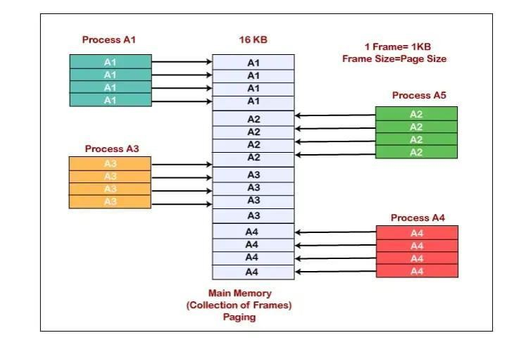
FLOW CHART :-

Slide 7
Advantages of Pagination Technique & Memory Management
◆ 1. Allocating memory is easy and cheap
◆ 2. Pages are mapped appropriately anyway
◆ 3. More efficient swapping
◆ 4. Allows demand paging and prepaging

Slide 8
Disadvantages of Paging Technique & Memory Management
◆ 1. Internal fragmentation is caused on older systems.
◆ 2. The memory lookup time is more in paging compared to segmentation.
◆ 3. Additional memory is consumed by the page tables.
◆ 4. Multi-level paging can cause memory reference.

Slide 9
THANKS

